Slide 1
Who Blessed You?
1 Corinthians 3
Dr. Rick Griffith • Crossroads International Church Singapore cicfamily.com & BibleStudyDownloads.org

Slide 2
What to do with a dead cat?

Slide 3
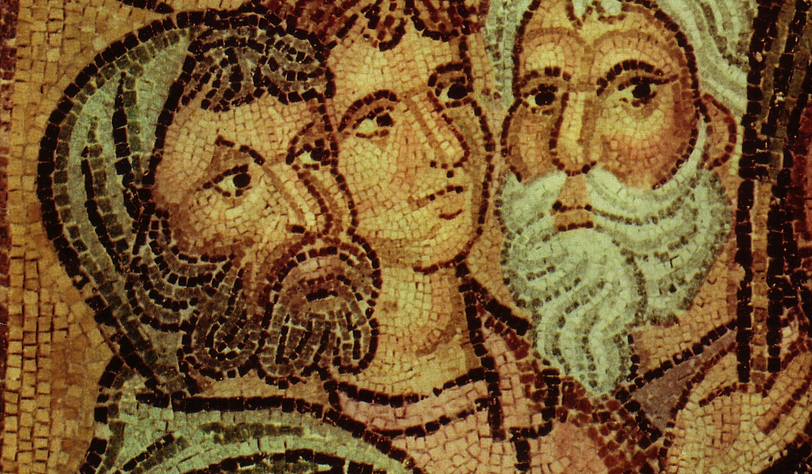
Parties at Corinth
Paul Action Party
P A P
Apollos Yippee Esquire
A Y E
Cephas Triumph Esquire
C T E
Savior Dvlpmnt Party
S D P

Slide 4
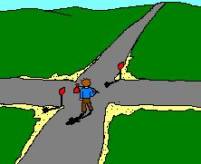
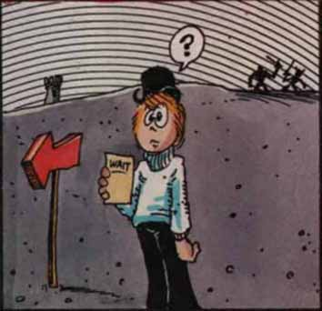
The Path to Unity: Focus on…
… things going right (1:1-9)
… God's wisdom (2:6-16)
… Christ crucified (1:10–2:5)

Slide 5
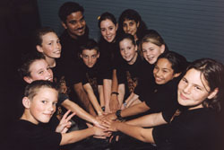
Church Unity
How can we keep it?

Slide 6
I. Don't be carnal by following only your favorite leader (1-4)
How to keep unity…

Slide 7
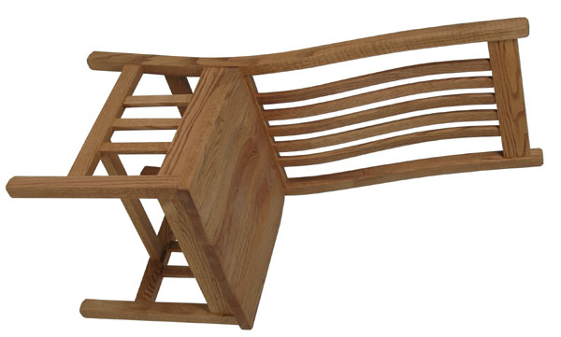
Who sits in your chair?

Slide 8
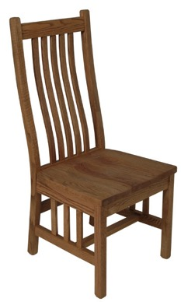
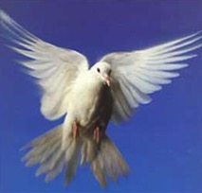
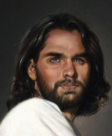
Types of People
?
?
Self
?
Self
"Man without the Spirit"
(Non-Christian)
2:14
"The Spiritual Man"
(Christian)
2:15

Slide 9
Types of People
Carnal Christian (3:1)
Self
Self
Self
Non-Christian (2:14)
Christian (2:15)

Slide 10
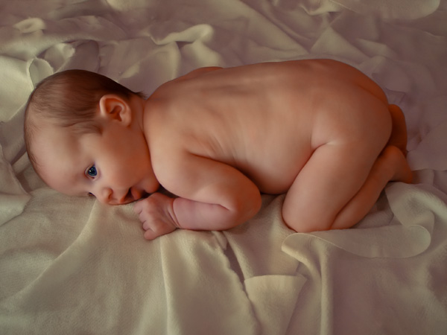
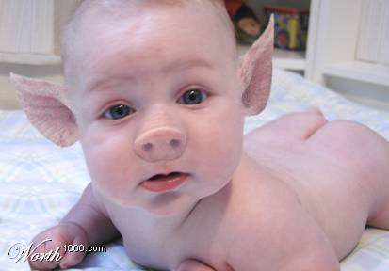
“Carnal” means “fleshly”

Slide 11
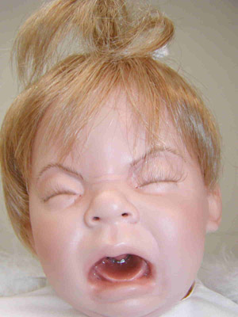
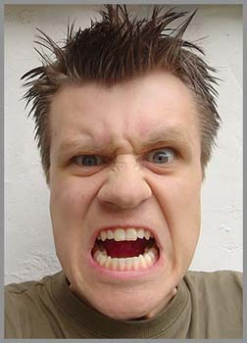
Two Types of Carnality
Sarkikos, "like flesh," 3:1
Sarkinos, "made of flesh," 3:3

Slide 12
Fleshly Advice…
You gotta look out for #1
You deserve a break today
so get up and get away to...
Notes:
12

Slide 13
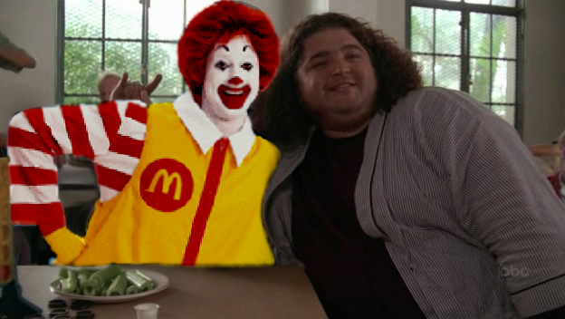
How Hugo Became Huge-o

Slide 14
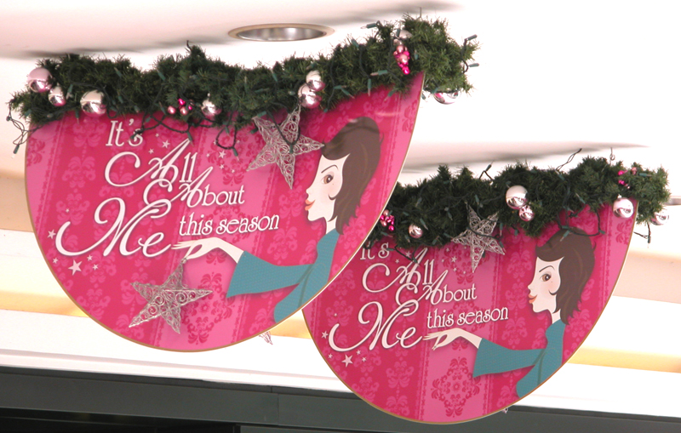
"It's All About Me" = Blatant Carnality

Slide 15
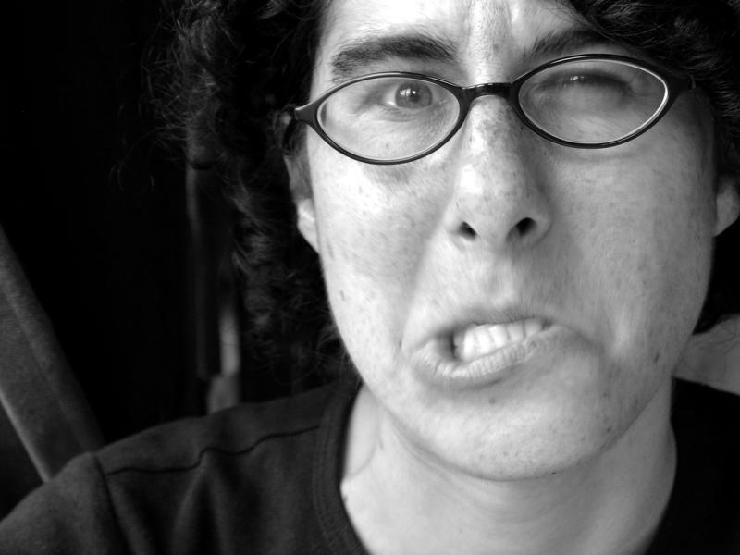
Carnality Selfishness
Can't understand (2)
Fight over rights (3)
Divide over leaders (4)

Slide 16
I. Don't be carnal by following only your favorite leader (1-4)
How to keep unity…

Slide 17
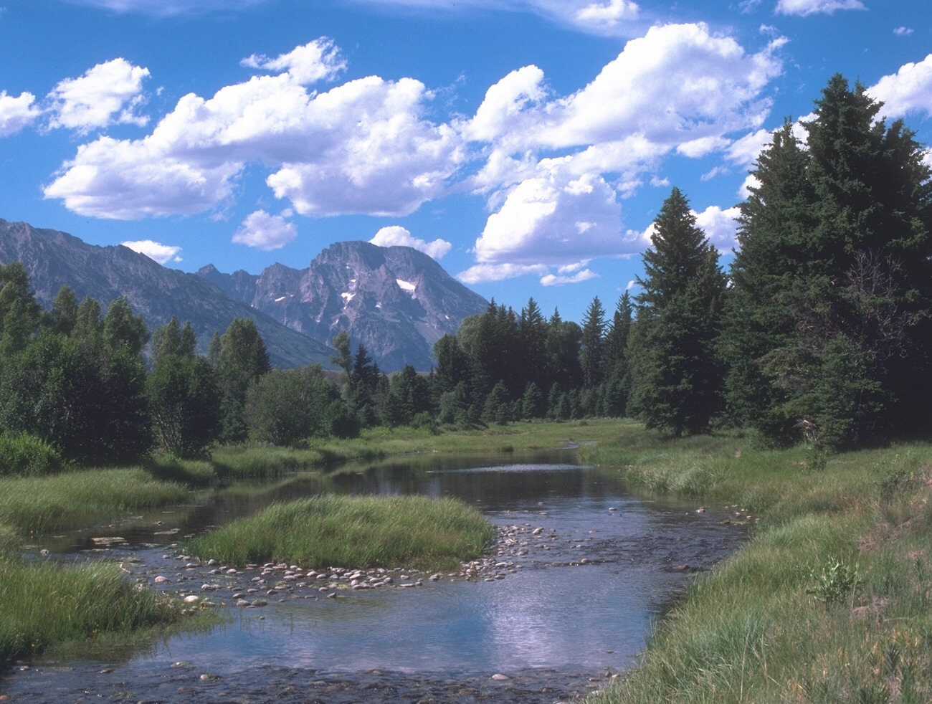
II. See all blessings as from God—not leaders (5-23)
How to keep unity…

Slide 18
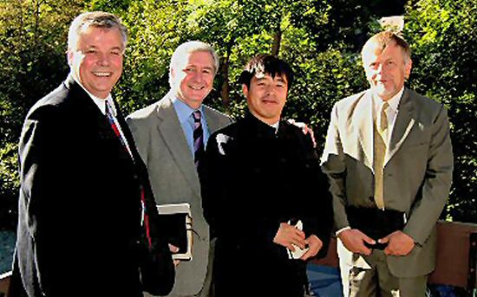
A. Leaders––like us all––are only instruments of God accountable to Him (5-15)

Slide 19
A. Leaders––like us all––are only instruments of God accountable to Him (5-15)
1. God causes church growth, not leaders (5-9).
2. God will reward each believer's service (10-15).

Slide 20
The Judgment Seat of Christ
Is this a judgment for to determine salvation?
Or is it to reward believers?

Slide 21
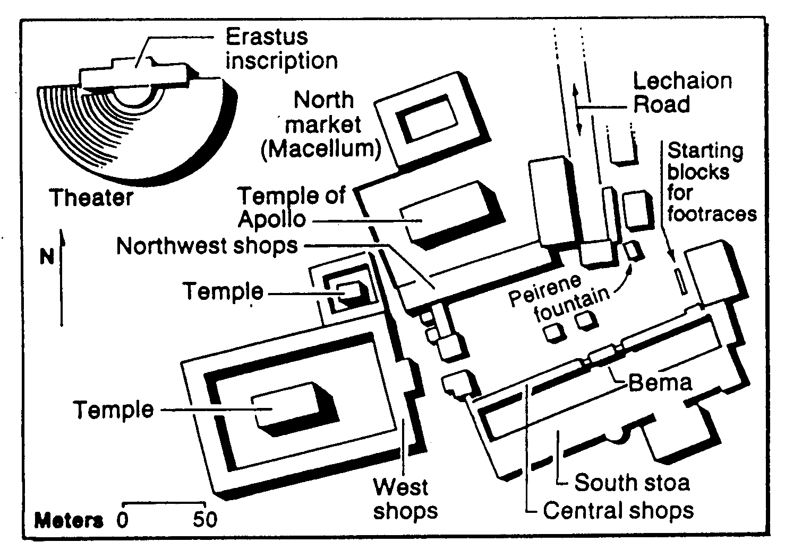
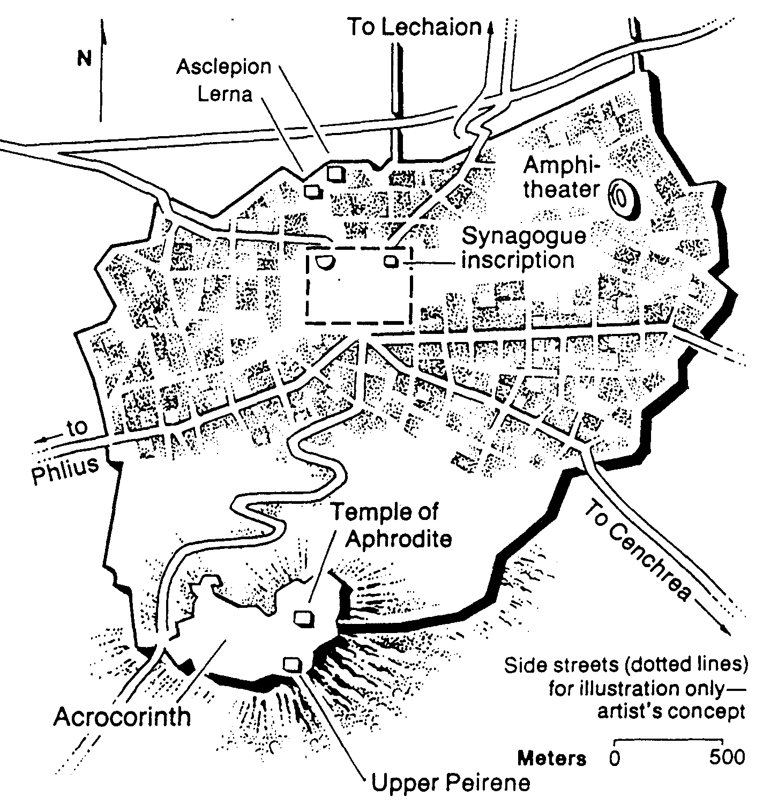
The Corinthian Marketplace
Bible Visual Resource Book, 235

Slide 22
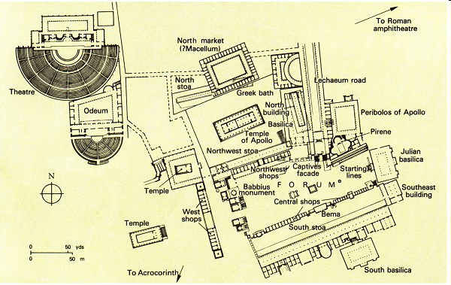
The Bema at Corinth
Lawsuits 1 Cor. 6
Bema
Paul at the speaker rostrum
Acts 18

Slide 23
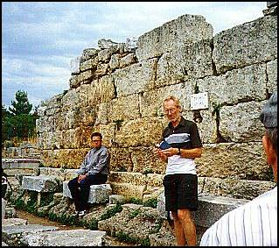
The Bema Still Exists
Notes:
23

Slide 24
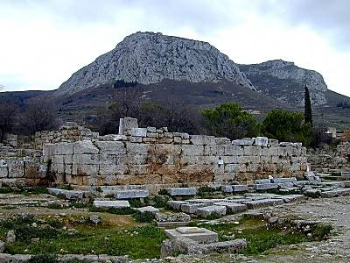
Bema with Acrocorinth in Distance
Notes:
24

Slide 25
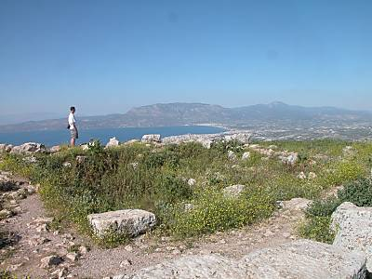
View from Acrocorinth
Notes:
25

Slide 26
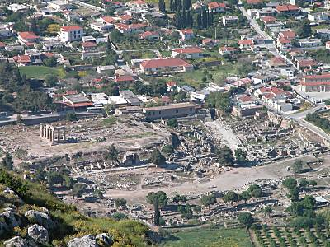
The Main City Below
Notes:
26

Slide 27
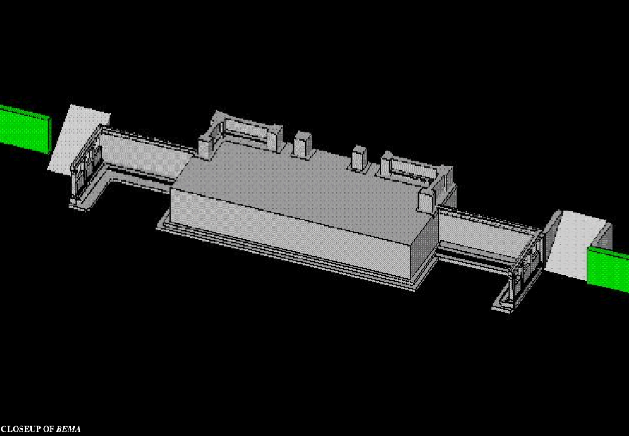
Bema Close-up
Notes:
27
http://corinth.sas.upenn.edu/schola.html

Slide 28
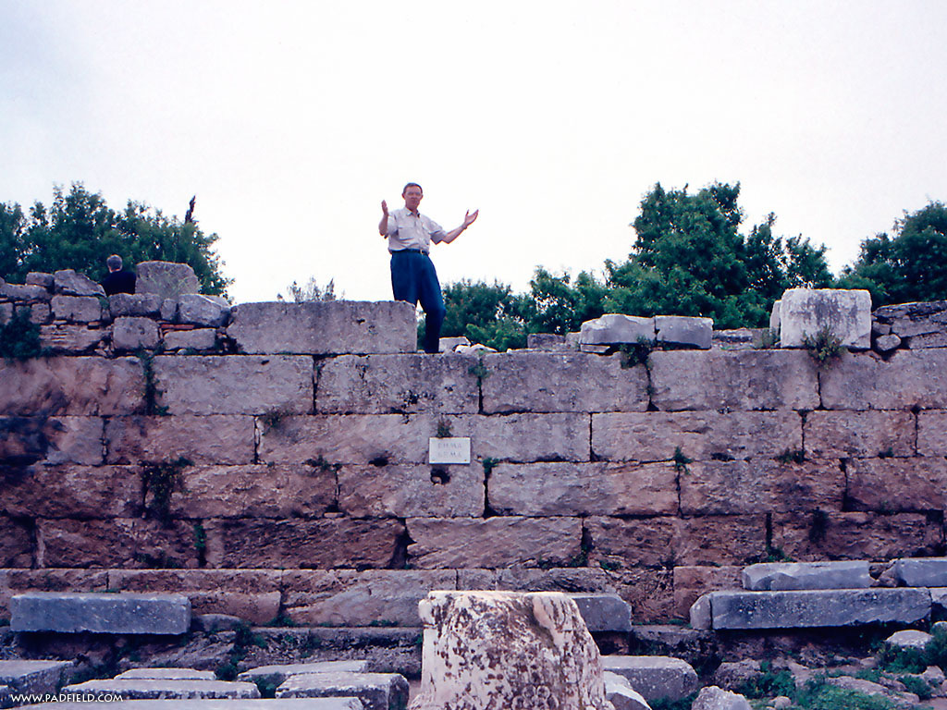
The Speaker or Judge Above
The Speaker or Judge Above
Notes:
28

Slide 29
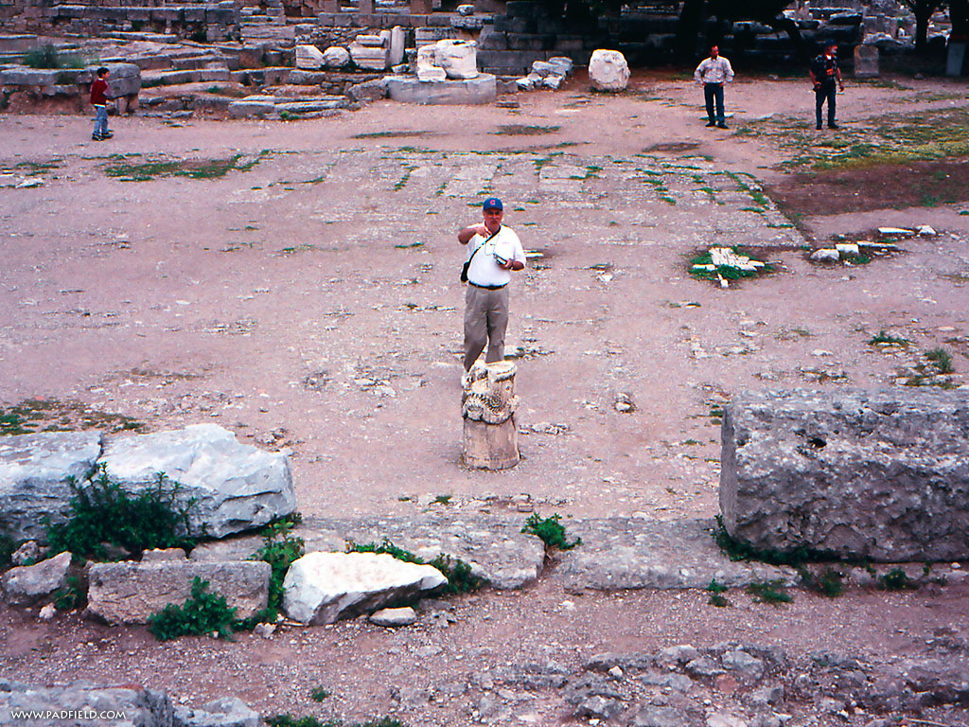
The One Being Judged or Rewarded Stood Below
Notes:
29

Slide 30
Bema for Rewards
"In Grecian games in Athens, the old arena contained a raised platform on which the president or umpire of the arena sat. From here he rewarded all the contestants; and here he rewarded all winners. It was called the 'bema' or 'reward seat.' It was never used of a judicial bench."
(L. Sale-Harrison, Judgment Seat of Christ, 8; cited by Pentecost, Things to Come, 220).
Really?
Notes:
30

Slide 31
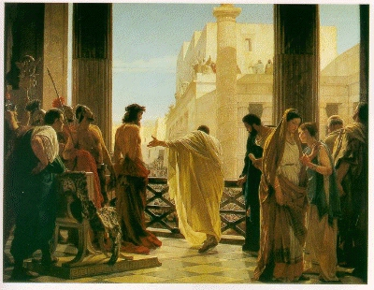
Jesus Before Pilate

Slide 32
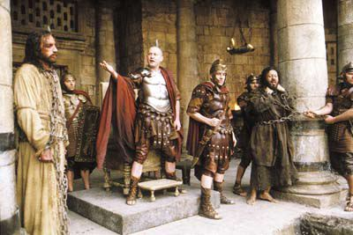
Jesus Before Pilate

Slide 33
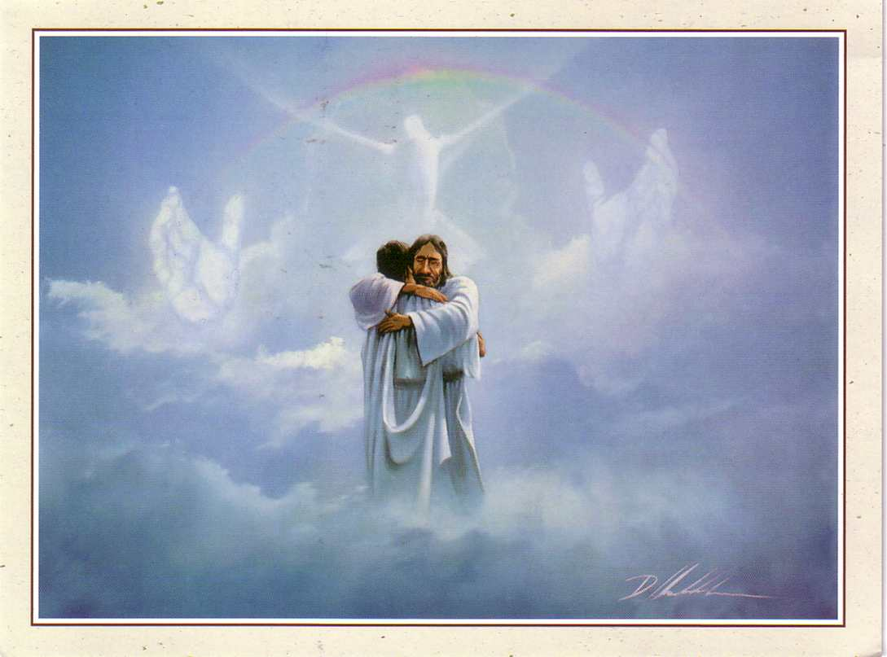
The Bema is a Reward Seat

Slide 34
Lasting Building Materials (3:12a)
Silver
Gold
Jewels
Foundation: Apostles & Prophets (Eph 2:20)
Foundation: The Lord Jesus Christ (1 Cor. 3:11)
Adapted from Charles R. Swindoll. "Spiritual Gifts Study Guide" (IFL, 1983), 7

Slide 35
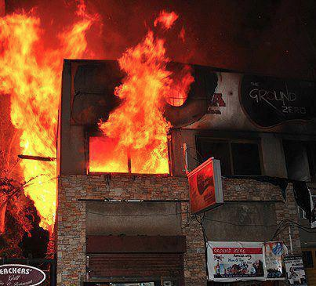
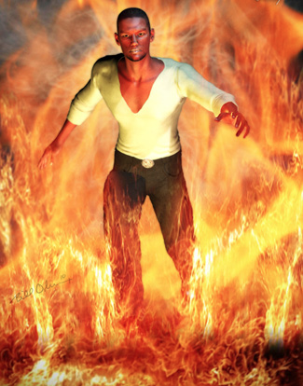
"saved as through fire…" (3:15)

Slide 36
Perishable Building Materials (3:12b)
Hay
Silver
Gold
Straw
Jewels
Wood
Foundation: Apostles & Prophets (Eph 2:20)
Foundation: The Lord Jesus Christ (1 Cor. 3:11)
Adapted from Charles R. Swindoll. "Spiritual Gifts Study Guide" (IFL, 1983), 7

Slide 37
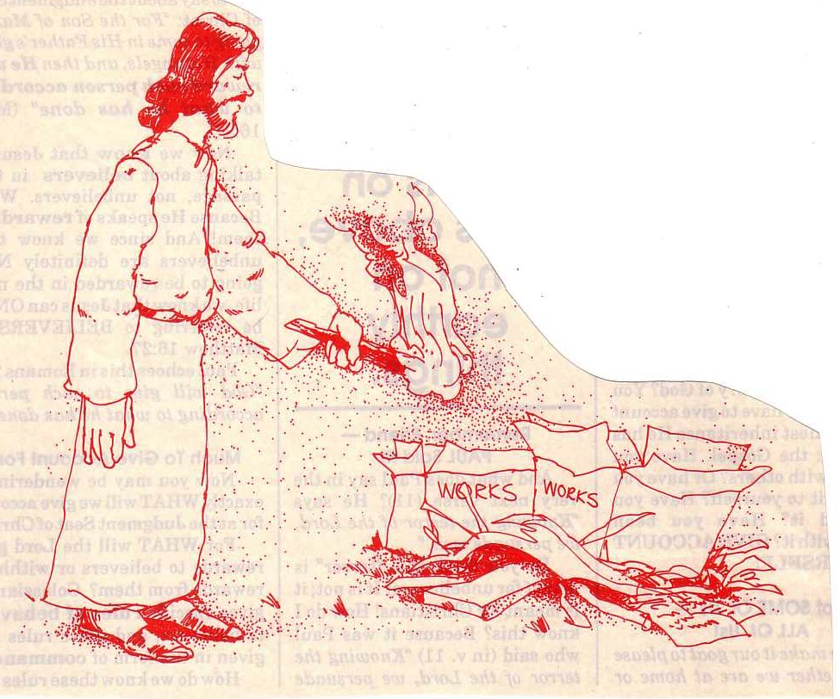
"… the fire will test the quality of each man's work" (1 Cor. 3:13)

Slide 38
A. Leaders––like us all––are only instruments of God accountable to Him (5-15)

Slide 39
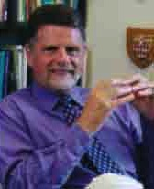
B. God deserves credit for our blessings, not any man (16-23).

Slide 40
B. God deserves credit for our blessings, not any man (16-23).
1. God indwells the church and will judge (16-17)
2. God gives true wisdom, not human wisdom (18-20)
3. God will give us everything in the world (21-23)

Slide 41
—Main Idea— Unity comes from seeing all blessings as from God—not from leaders

Slide 42
Black
Notes:
42

Slide 43
Types of People
Carnal Christian (3:1)
Self
Can you digest the meat?
Do you unify our body?
Self
Self
Non-Christian (2:14)
Christian (2:15)

Slide 44
Black

Slide 45
NT Preaching link at BibleStudyDownloads.org
Get this presentation and script for free!
Notes:
NT Preaching (np)

